Slide 1

Computer Networks
Application Layer

Slide 2
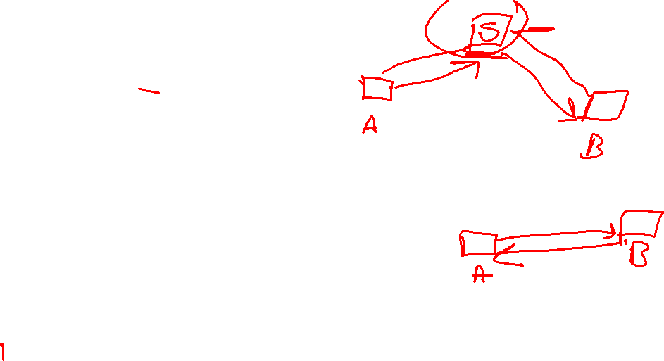
Topic of the day
Peer to Peer Paradigm
Centralized Network
Decentralized Networks(Unstructured & Structured)
Distributed Hash Tables
P2P Network Protocols(Chord, Pastry, Kademlia)
BitTorrent (Trackerless & with Tracker)
BlockChain (Cryptocurrencies, Smart Contracts, Supply Chain)

Slide 3
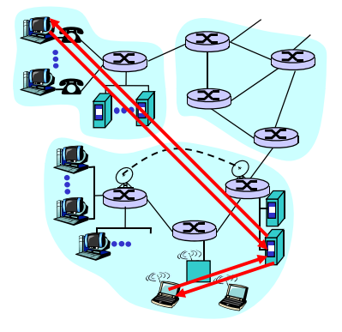

Client-Server Architecture
Server:
Always-on host
permanent IP address
Server farms for Scaling
Clients:
communicate with server
may be intermittently connected
may have dynamic IP addresses
Do not directly communicate with each other

Slide 4
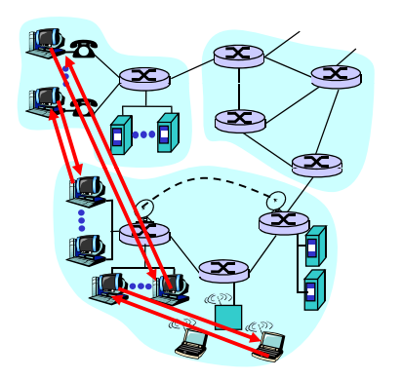
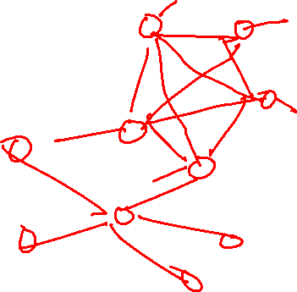
Peer to Peer Architecture
No always-on server
arbitrary end systems directly communicate
peers are intermittently connected and change IP addresses
example: Gnutella
Highly scalable
Difficult to manage

Slide 5
Examples
Freenet: (1999) censorship-resistant network providing anonymity
Napster: (1999-2001) music file sharing service
Gnutella: (2000) File sharing system
Fast Track(Kazaa)
BitTorrent
WinMax
GNUnet
BitCoin
Etherum
InterPlanetry File System

Slide 6
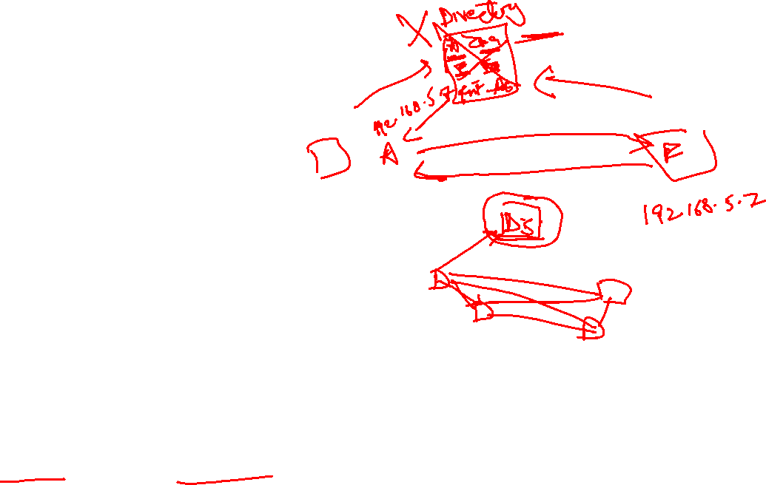
Types
Centralized P2P Network
Hybrid system
Directory System: Listing of peers centralized(Client-Server)
Easy & Simple Maintenance
Central point of Failure
Traffic issues on the server
Vulnerable to attacks
Decentralized P2P Network
No centralized Directory
Overlay network of peers(Logical Network)
2 types depending on how the nodes are linked in the overlay network
Structured and Unstructured

Slide 7
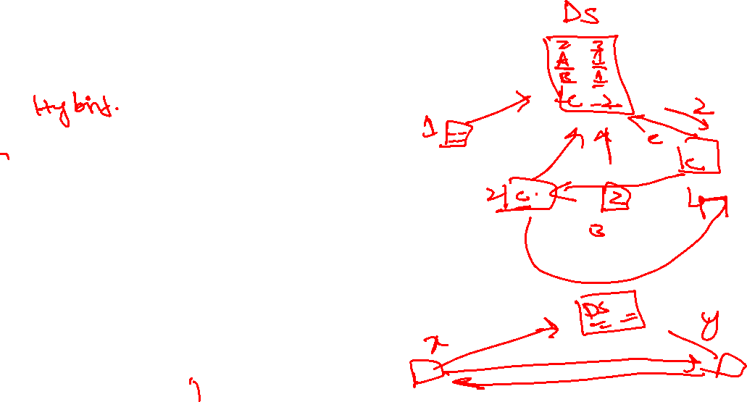
Centralized P2P Network
Napster
File Transfer P2P
File search centralized:
Peers register content at central server
Peers query same central server to locate content
Instant messaging
Chatting between two users is P2P
Presence detection/location centralized:
User registers its IP address with central server when it comes online
User contacts central server to find IP addresses of buddies
Notes:
Napster was shut down due to copyright issues. Napster 2 is now legal pay for music site

Slide 8
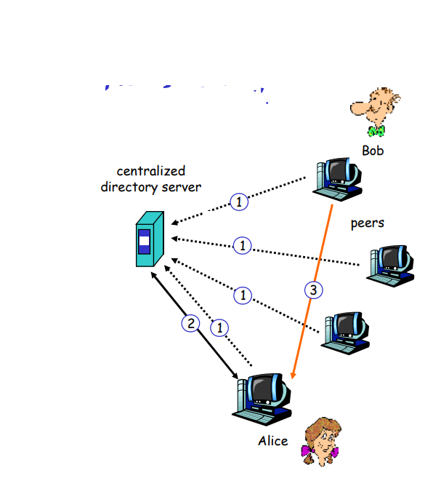
Original “Napster” design
When peer connects, it informs
centralized directory server
informs central server:
IP address
Content peers
Alice queries for “Hey
Jude”
Alice requests file from
Bob

Slide 9
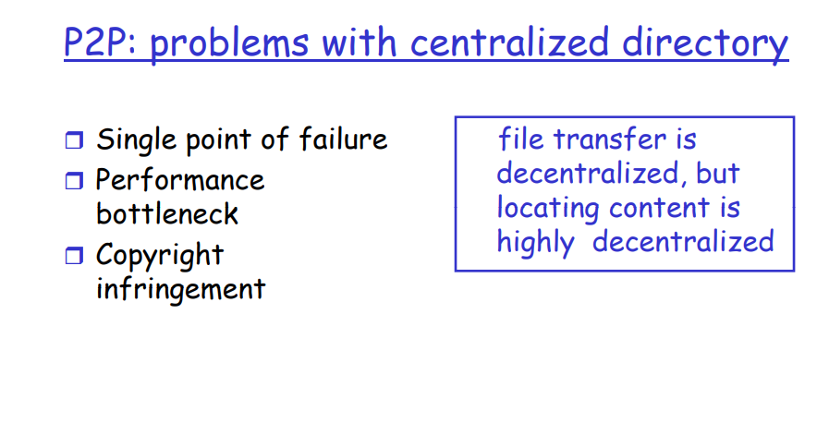

Slide 10
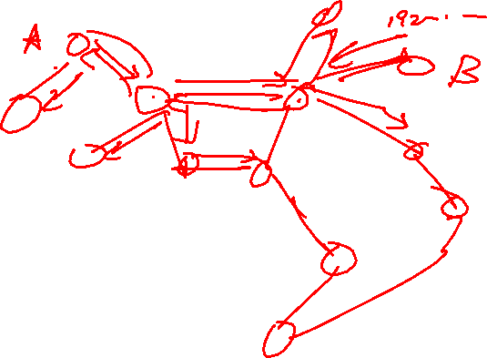
Unstructured Network
Randomly linked nodes
Search is not efficient
Network flooding with query as links are random
Generate a lot of traffic
Query resolution takes time or sometimes not resolved
Examples:
Gnutella
Freenet

Slide 11
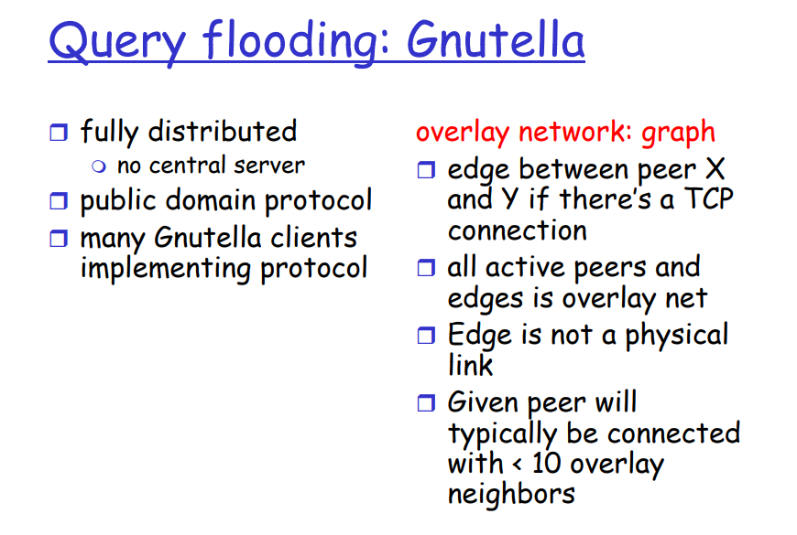

Slide 12
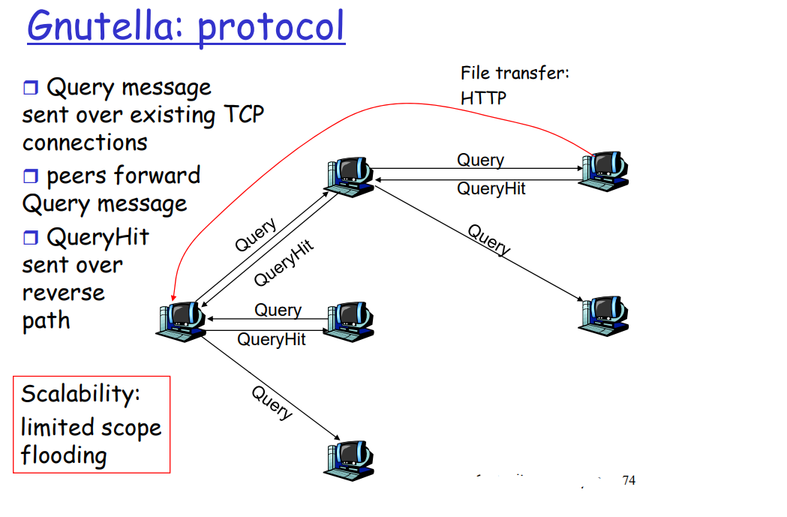


Slide 13
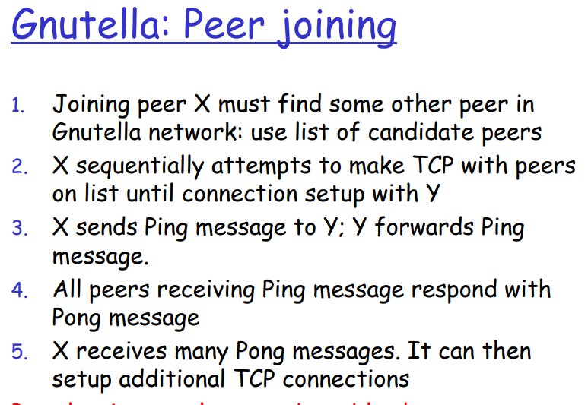

Slide 14
Structured Networks
Predefined rules to link nodes
Effective and efficient resolution of queries
Most Common technique- DHT
Many Applications of DHTs
Distributed Data Structures DDS
Content Distribution Systems CDS
DNS
P2P File Sharing - BitTorrent
Notes:
DNS Uses DHT - Hometask

Slide 15
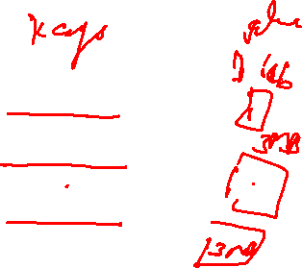
What is a DHT?
Hash Table
data structure that maps “keys” to “values”
essential building block in software systems
Distributed Hash Table (DHT)
similar, but spread across many hosts
Interface
insert(key, value)
lookup(key)

Slide 16
How do DHTs work?
Every DHT node supports a single operation:
Given key as input; route messages to node holding key
DHTs are content-addressable

Slide 17

DHT: basic idea
K V
K V
K V
K V
K V
K V
K V
K V
K V
K V
K V

Slide 18
DHT: basic idea
K V
K V
K V
K V
K V
K V
K V
K V
K V
K V
K V
Neighboring nodes are “connected” at the application-level

Slide 19
DHT: basic idea
K V
K V
K V
K V
K V
K V
K V
K V
K V
K V
K V
Operation: take key as input; route messages to node holding key

Slide 20
DHT: basic idea
K V
K V
K V
K V
K V
K V
K V
K V
K V
K V
insert(K₁,V₁)
K V
Operation: take key as input; route messages to node holding key

Slide 21

DHT: basic idea
K V
K V
K V
K V
K V
K V
K V
K V
K V
K V
insert(K₁,V₁)
K V
Operation: take key as input; route messages to node holding key

Slide 22
DHT: basic idea
(K₁,V₁)
K V
K V
K V
K V
K V
K V
K V
K V
K V
K V
K V
Operation: take key as input; route messages to node holding key

Slide 23

DHT: basic idea
K V
K V
K V
K V
K V
K V
K V
K V
K V
K V
K V
retrieve (K₁)
Operation: take key as input; route messages to node holding key

Slide 24
How to design a DHT?
State Assignment:
what “(key, value) tables” does a node store?
Network Topology:
how does a node select its neighbors?
Routing Algorithm:
which neighbor to pick while routing to a destination?
Various DHT algorithms make different choices
CAN, Chord, Pastry, Tapestry, Plaxton, Viceroy, Kademlia, Skipnet, Symphony, Koorde, Apocrypha, Land, ORDI …

Slide 25
nodeID= hash(peer IP address)
key= hash(Object Name)
(Key, value) pair is stored.
Value is the actual Content
Notes:
Cryptographic hash function Secure Hash Algorithm SHA used. Collision resistant
2 methods for storing the objects – Direct & Indirect

Slide 26

What is BitTorrent
Designed for fast, efficient content distribution
Ideal for large files, e.g. movies, DVDs, ISOs, etc.
Uses P2P file swarming
Not a full fledged P2P system
Does not support searching for files
File swarms must be located out-of-band
Trackers acts a centralized swarm coordinators
Fully P2P, trackerless torrents are now possible
Insanely popular
35-70% of all Internet traffic

Slide 27








BitTorrent Overview
Tracker
Swarm
Seeder
Leechers

Slide 28
.torrent File
Contains all meta-data related to a torrent
File name(s), sizes
Torrent hash: hash of the whole file
URL of tracker(s)
BitTorrent breaks files into pieces
64 KB – 1 MB per piece
.torrent contains the size and SHA-1 hash of each piece
Basically, a .torrent tells you
Everything about a given file
Where to go to start downloading
Notes:
256 KB chunk size

Slide 29
Torrent Sites
Just standard web servers
Allow users to upload .torrent files
Search, ratings, comments, etc.
Some also host trackers
Many famous ones
Mostly because they host illegal content
Legitimate .torrents
Linux distros
World of Warcraft patches

Slide 30
Torrent Trackers
Tracker
Really, just a highly specialized webserver
BitTorrent protocol is built on top of HTTP
Keeps a database of swarms
Swarms identified by torrent hash
State of each peer in each swarm
IP address, port, peer ID, TTL
Status: leeching or seeding
Optional: upload/download stats (to track fairness)
Returns a random list of peers to new leechers

Slide 31
Peer Selection
Tracker provides each client with a list of peers
Which peers are best?
Truthful (not cheating)
Fastest bandwidth
Option 1: learn dynamically
Try downloading from many peers
Keep only the best peers
Strategy used by BitTorrent
Option 2: use external information
E.g. Some torrent clients prefer peers in the same ISP

Slide 32
Sharing Pieces
Initial Seeder
1
2
3
4
5
6
7
8
1
2
3
4
5
6
7
8
1
2
3
4
5
6
7
8
Leecher
Leecher
Seeder
Seeder

Slide 33
The Beauty of BitTorrent
More leechers = more replicas of pieces
More replicas = faster downloads
Multiple, redundant sources for each piece
Even while downloading, leechers take load off the seed(s)
Great for content distribution
Cost is shared among the swarm

Slide 34
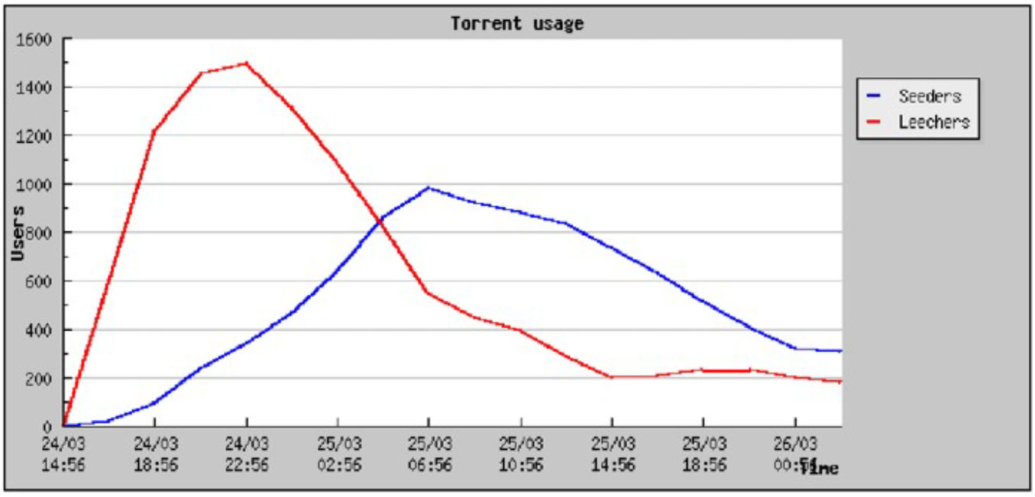
Typical Swarm Behavior

Slide 35
“Trackerless” BitTorrent
To be more precise, “BitTorrent without a centralized-tracker”
E.g.: Azureus
Uses a Distributed Hash Table (Kademlia DHT)
Tracker run by a normal end-host (not a web-server anymore)
The original seeder could itself be the tracker
Or have a node in the DHT randomly picked to act as the tracker

Slide 36
BlockChain Technology
Distributed Ledger
Cryptocurrencies
Smart Contracts
Supply Chain
E-Voting
Health Care
Notes:
Tree, DHTs,

Slide 37
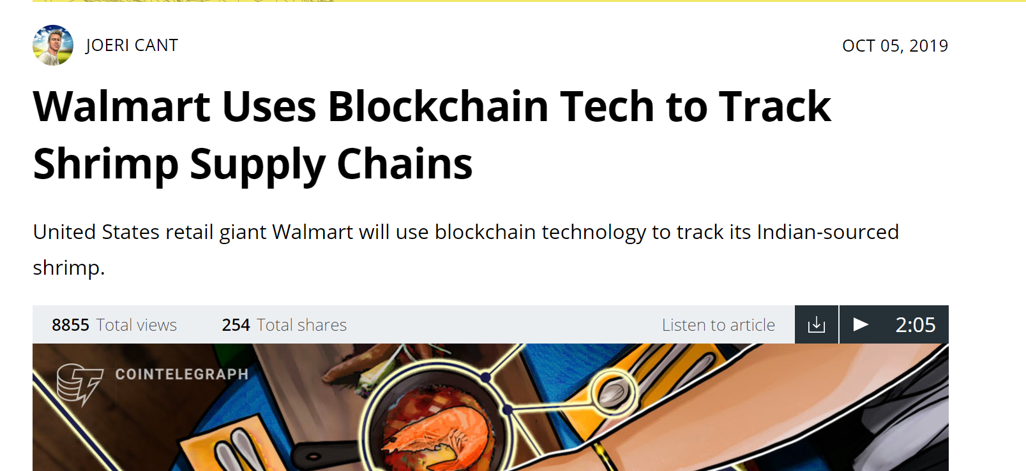

Slide 38
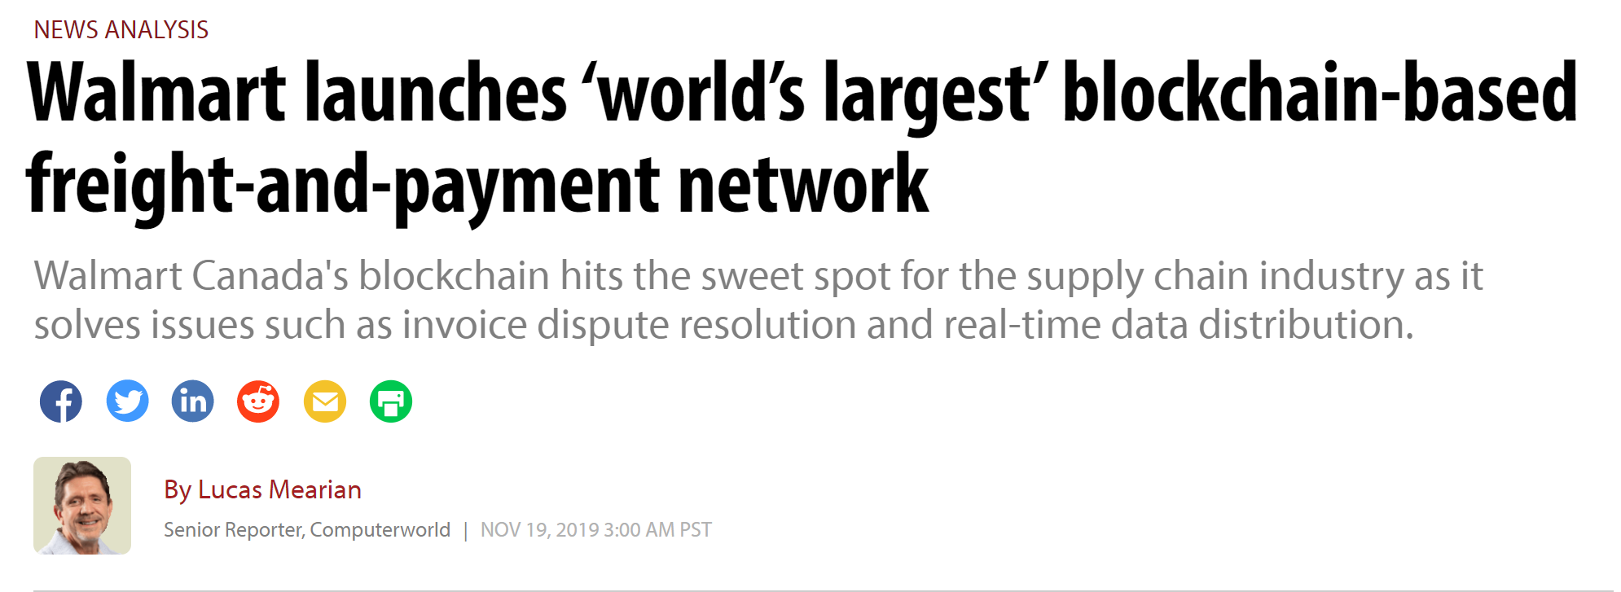

Slide 39
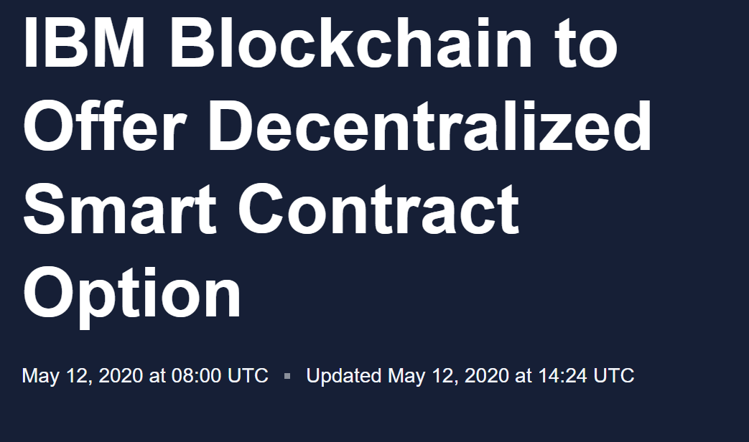

Slide 40


Slide 41
References
https://slideplayer.com/slide/3299585/
https://www.digitalcitizen.life/what-is-p2p-peer-to-peer/
BitTorrent
“Incentives build robustness in BitTorrent”, Bram Cohen
BitTorrent Protocol Specification: http://www.bittorrent.org/protocol.html
Poisoning/Pollution in DHT’s:
“Index Poisoning Attack in P2P file sharing systems”
“Pollution in P2P File Sharing Systems”

